Slide 1

Machine Learning and Data Mining
Lecture 3.1: Perceptron, Evaluating Classifiers, Naïve Bayes

Slide 3
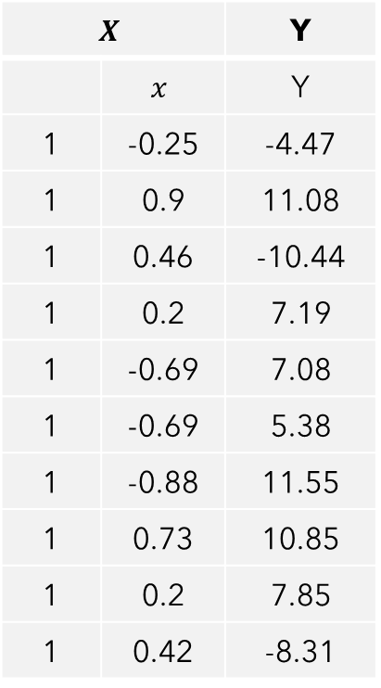
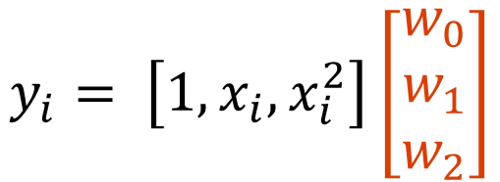

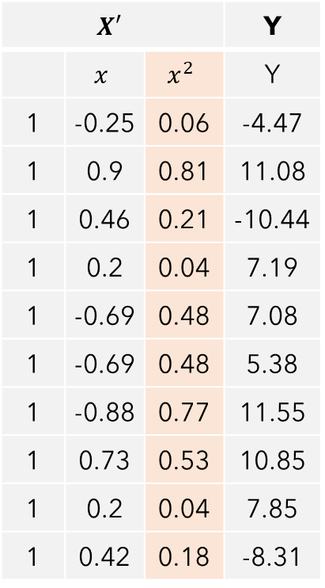
Beyond Lines but Still Linear?
Idea: Solve a linear regression problem in a feature space that is non-linear in the original input! For example, could add a $x^{2}$ term.
$$X$$ | X | Y
 | $$x$$ | Y
1 | -0.25 | -4.47
1 | 0.9 | 11.08
1 | 0.46 | -10.44
1 | 0.2 | 7.19
1 | -0.69 | 7.08
1 | -0.69 | 5.38
1 | -0.88 | 11.55
1 | 0.73 | 10.85
1 | 0.2 | 7.85
1 | 0.42 | -8.31
$$X′$$ | X |  | Y
 | $$x$$ | $$x^{2}$$ | Y
1 | -0.25 | 0.06 | -4.47
1 | 0.9 | 0.81 | 11.08
1 | 0.46 | 0.21 | -10.44
1 | 0.2 | 0.04 | 7.19
1 | -0.69 | 0.48 | 7.08
1 | -0.69 | 0.48 | 5.38
1 | -0.88 | 0.77 | 11.55
1 | 0.73 | 0.53 | 10.85
1 | 0.2 | 0.04 | 7.85
1 | 0.42 | 0.18 | -8.31
Solve for w such that:
$$y_{i}=w_{0}1+w_{1}x_{i}+w_{2}x_{i}^{2}$$
Linear function of non-linear transformations of x
$$y_{i}= \left[1, x_{i},x_{i}^{2}\right]\left[\begin{matrix}w_{0} \\ w_{1} \\ w_{2}\end{matrix}\right]$$

Slide 4
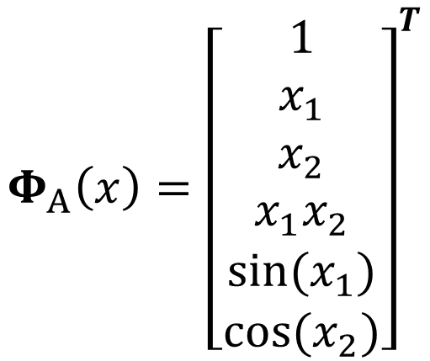
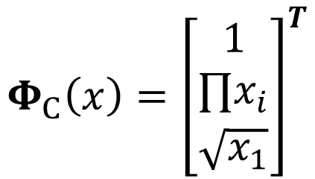
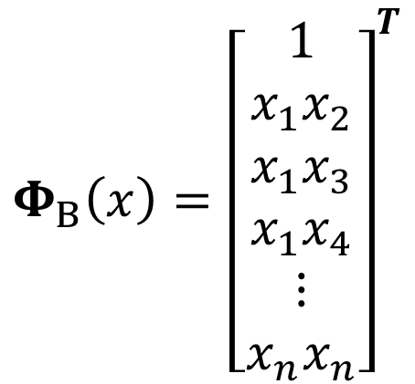

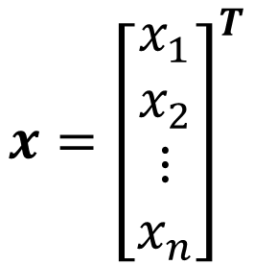
Linear Regression over Basis Functions
Let’s generalize this further.
Each data point has $d$ features. Let $Φ: ℝ^{d}→ℝ^{d^{′}}$ be our basis function. Can make any arbitrary choice we want here based on how the data looks.
$$Φ_{A}\left(x\right)={\left[\begin{aligned}1 \\ x_{1} \\ x_{2} \\ x_{1}x_{2} \\ sin⁡(x_{1}) \\ cos⁡(x_{2})\end{aligned}\right]}^{T}$$
$$Φ_{B}\left(x\right)={\left[\begin{aligned}1 \\ x_{1}x_{2} \\ x_{1}x_{3} \\ x_{1}x_{4} \\ ⋮ \\ x_{n}x_{n}\end{aligned}\right]}^{T}$$
$$x={\left[\begin{aligned}x_{1} \\ x_{2} \\ ⋮ \\ x_{n}\end{aligned}\right]}^{T}$$
$$Φ_{C}\left(x\right)={\left[\begin{aligned}\begin{aligned}1 \\ ∏x_{i}\end{aligned} \\ \sqrt{x_{1}}\end{aligned}\right]}^{T}$$
$$1×d$$
No matter what we choose, the procedure is the same. Replace each $x$ (row) in our data matrix with $Φ\left(x\right)$, then solve the linear regression problem.

Slide 5
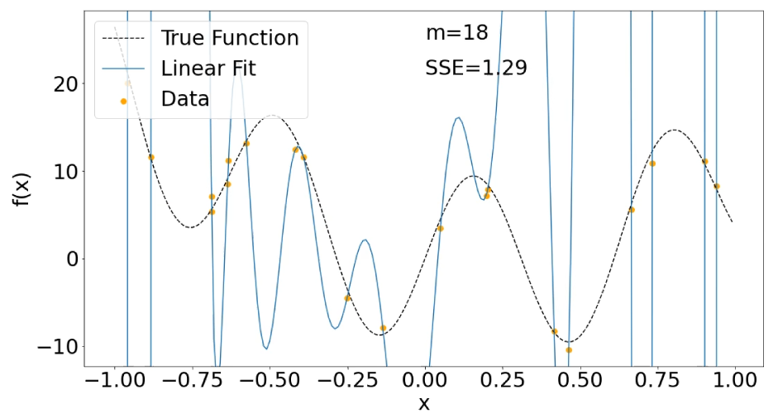
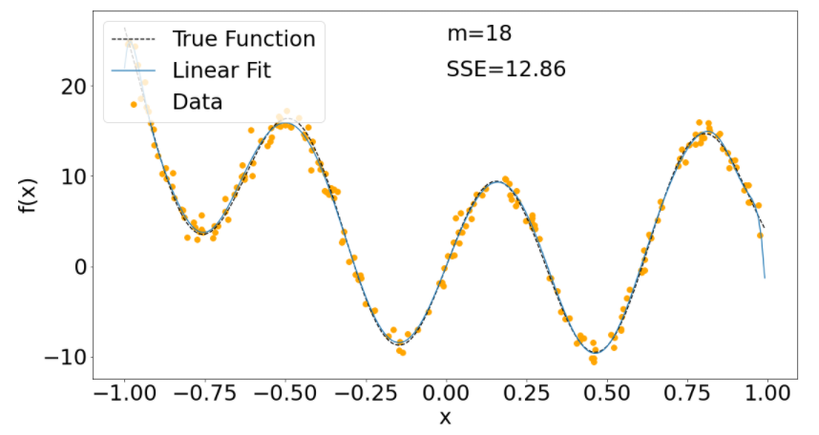
Techniques for Avoiding Overfitting
What can we do to reduce overfitting?
View it as an estimation error
Solution: Get more data
Do model selection to find a simpler model
Less complicated model, less data needed.
Regularization
Add a prior belief that the model should be simple!
Okay. But how to encode this?

Slide 6



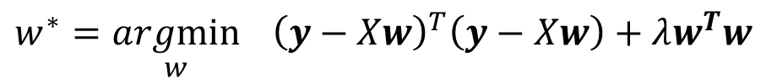
L2 Regularization
Regularizer View
Bayesian View
Add a regularization penalty $λw^{T}w$ to the SSE
Assume a Gaussian prior
$$w∼𝒩\left(\vec{0}, βI\right)$$
$$w^{∗}=\underset{w}{argmin}{ {\left(y−Xw\right)}^{T}\left(y−Xw\right)+λw^{T}w}$$
$$w^{∗}=\underset{w}{argmax}{ logP\left(D | w\right)+logP(w)}$$
Arrive at the same solution for L2 regularized least squares.
$$w^{∗}={\left(X^{T}X+λI\right)}^{−1}X^{T}y$$

Slide 7
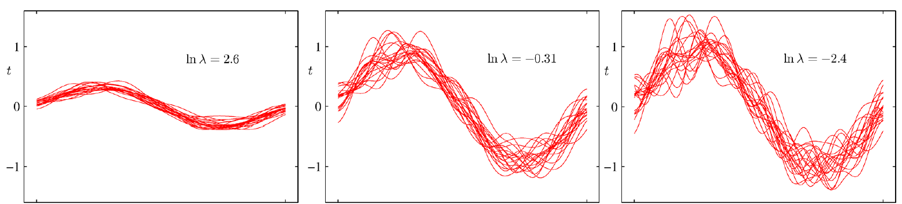



Effect of Regularization – Example 2
Each red line is the result of a 9th degree polynomial fit on 10 random points noisily sampled from the true curve.
$$λ≈13.46$$
$$λ≈0.73$$
$$λ≈0.09$$
Smaller $λ$ resulted in more complex curves that better fit the data but has a high variance.

Slide 8
Summary of Regularization
Regularization is a much more general concept in machine learning. Consider any learning task to minimize a loss $ℒ(w)$ on the training data – could add a regularizer term.
$$w^{∗}=\underset{w}{argmin}{ℒ\left(w\right)+λ∗regularizer(w)}$$
Generally speaking, larger $λ′s$ lead to simpler models and reduce overfitting, smaller $λ^{′}s$ lead to more complex models but improve fit on training data.
Most commonly used regularizers are based on the norm of the weight vector.

Slide 9
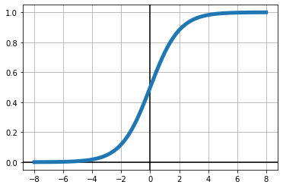


Why not regress probabilities directly?
Introducing the logistic function:
May also see it referred to as a sigmoid function or “logit” function
Logistic Function $σ\left(z\right)=\frac{1}{1+e^{−z}}$
Maps $(−∞, ∞)$ to $(0,1)$

Slide 10

Logistic Regression
Logistic Regression Model Assumption:
$$P\left(y_{i}=1 | x_{i};w\right)=σ\left(w^{T}x\right)=\frac{1}{1+e^{−w^{T}x}}$$
$$P\left(y_{i}=0 | x_{i};w\right)=1−σ\left(w^{T}x\right)=\frac{e^{w^{T}x}}{1+e^{−w^{T}x}}$$

Slide 11
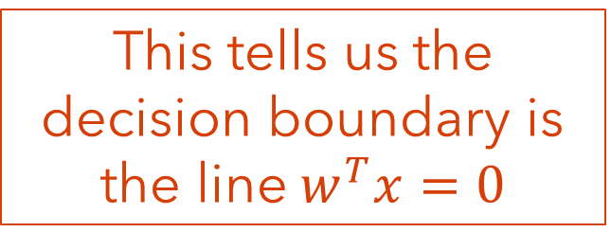
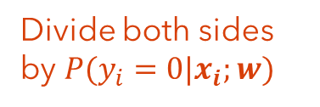

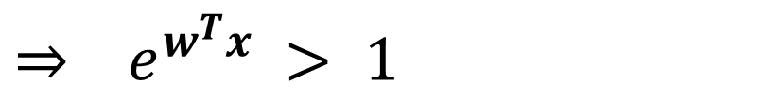
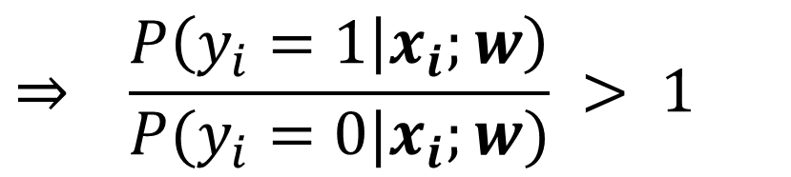
Logistic Regression
Logistic Regression Model’s Decision Boundary:
Predict $1$ if
$$P\left(y_{i}=1 | x_{i};w\right)>P(y_{i}=0|x_{i};w)$$
$$⇒ \frac{P\left(y_{i}=1 | x_{i};w\right)}{P(y_{i}=0|x_{i};w)} > 1$$
Divide both sides by $P(y_{i}=0|x_{i};w)$
$$⇒ e^{w^{T}x} > 1$$
Just some algebra
This tells us the decision boundary is the line $w^{T}x=0$
Log of both sides
$$⇒ w^{T}x >0$$

Slide 12
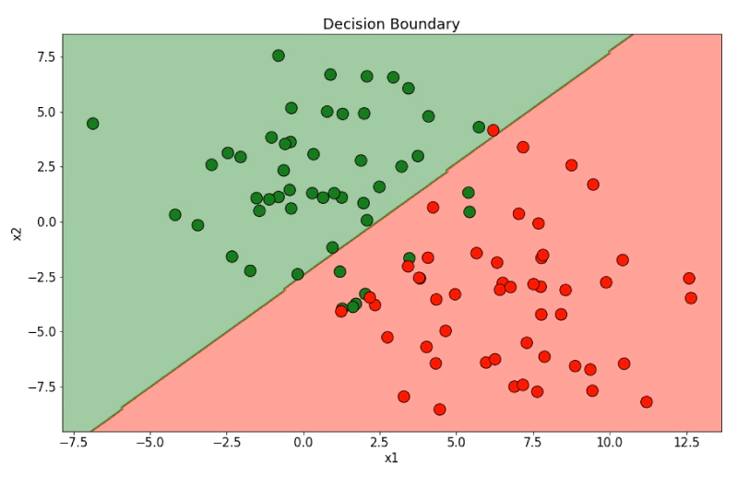
Logistic Regression
Example logistic regression decision boundary – linear in the features.

Slide 13
Be able to answer:
What is the perceptron linear classifier?
How is it updated?
How to evaluate classification models?
Accuracy
Recall and Precision

Slide 14
Perceptron vs Logistic Regression -- History
1830s Logistic function invented
1943 Logistic Regression invented but in biology and largely ignored
1958 Perceptron invented and popularized in AI/ML communities
1970s Logistic Regression reached widespread recognition

Slide 15
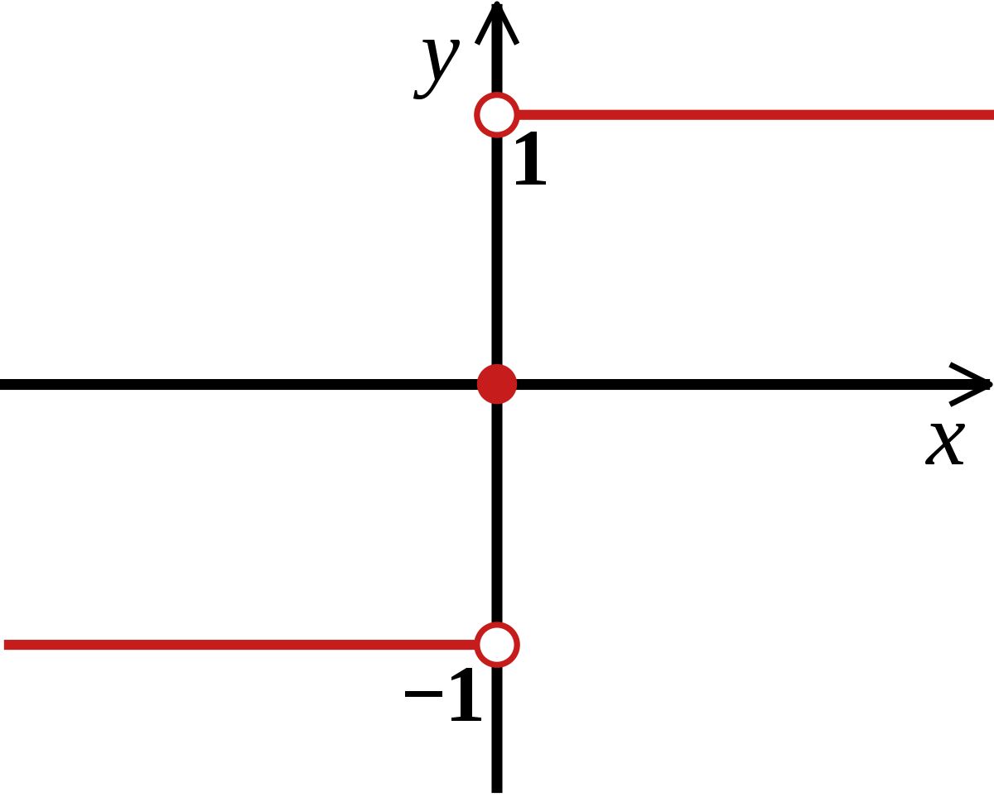
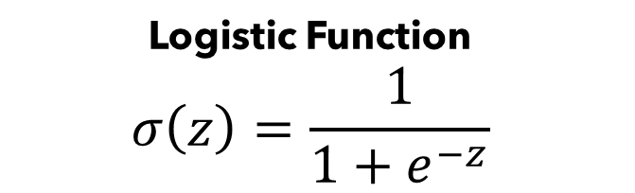
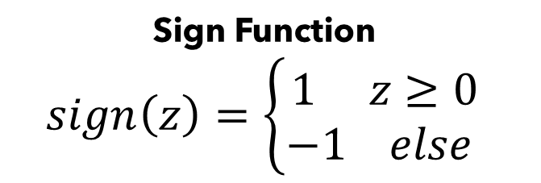
Perceptron vs Logistic Regression
Logistic Function
$$σ\left(z\right)=\frac{1}{1+e^{−z}}$$
Sign Function
$$sign\left(z\right)=\left\{\begin{aligned}1 z≥0 \\ −1 else \end{aligned}\right.$$

Slide 16

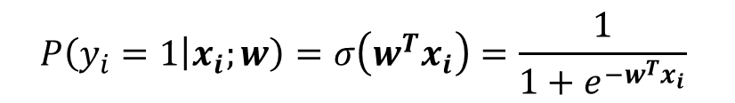
Perceptron vs Logistic Regression
Logistic Regression
Perceptron
$$P\left(y_{i}=1 | x_{i};w\right)=σ\left(w^{T}x_{i}\right)=\frac{1}{1+e^{−w^{T}x_{i}}}$$
$$y_{i}=sign(w^{T}x_{i})$$
$$y_{i}=argmax_{y} P(y|x_{i};w)$$
Linear Classifier
Linear Classifier
Probabilistic Interpretation
No useful probabilistic interpretation (mostly just geometry)
Trained with gradient descent or other optimization methods
Trained with the “perceptron” algorithm

Slide 17

The Perceptron: Setup
Consider a binary prediction problem where we are given a dataset of $x_{i}, y_{i}$ pairs where $y_{i}∈\left\{−1,1\right\}.$ We want to find optimal linear weights $w$ such that:
$$y_{i}=sign\left(w^{T}x_{i}\right) ∀i$$
This is equivalent to saying we want:
$$y_{i}w^{T}x_{i}>0 ∀i$$
If $y_{i}$ and $w^{T}x_{i}$ have same sign, then sign($w^{T}x_{i}$) will equal $y_{i}$

Slide 18

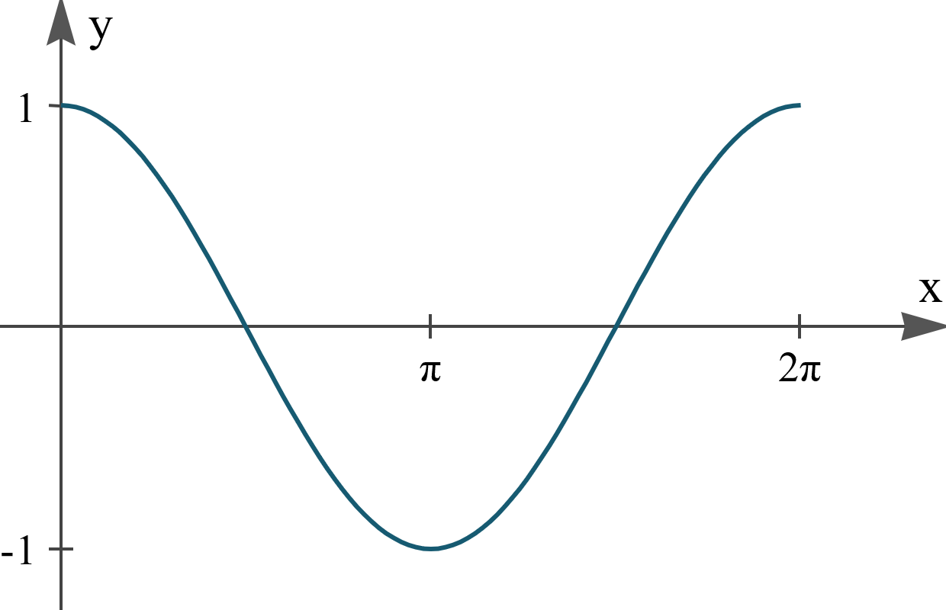



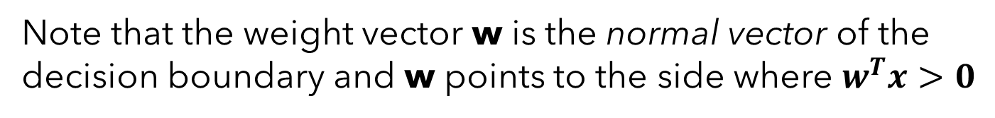












The Perceptron: Setup
Note that the weight vector w is the normal vector of the decision boundary and w points to the side where $w^{T}x>0$
$$w_{t}^{T}x>0$$
$$w_{t}$$
Every point where $w^{T}x=0$ lies along the line perpendicular to $w$. Why? Linear algebra.
$$w_{t}^{T}x<0$$
Linear Algebra Fact: Dot product of two vectors is proportional to the cosine of the angle between them.
$$\vec{v}⋅\vec{x}=\left|\vec{x}\right|\left|\vec{w}\right|\cos{θ}$$
$$\vec{x}$$
$$\cos{θ}$$
$$θ$$
$$θ$$
$$0$$
$$90$$
$$180$$
$$270$$
$$360$$
$$\vec{w}$$

Slide 19
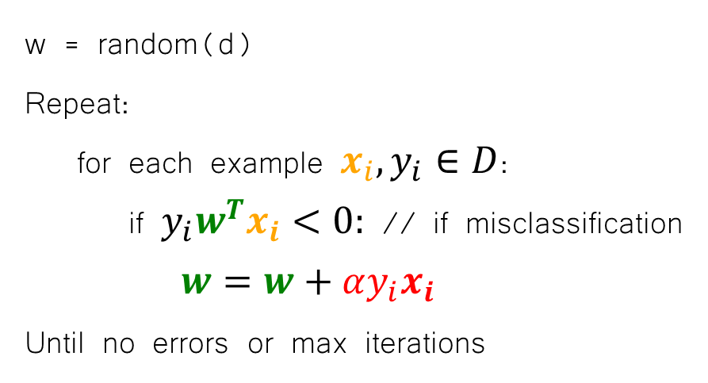
The Perceptron: Learning Algorithm
Trained with a simple iterative algorithm
Perceptron Learning Algorithm
w = random(d)
Repeat:
for each example $x_{i}, y_{i}∈D$:
if $y_{i}w^{T}x_{i}<0:$ // if misclassification
$w=w+αy_{i}x_{i}$
Until no errors or max iterations

Slide 20







The Perceptron: Effect of Update Rule
Consider how adding $αy_{i}x_{i}$ to the weights changes the “error” of a point. Let $w_{t}$ be the weights before the update and $w_{t+1}$ be after the update -- $w_{t+1}=w_{t}+αy_{i}x_{i}$.
$$y_{i}w_{t+1}^{T}x_{i}=y_{i}{\left(w_{t}+αy_{i}x_{i}\right)}^{T}x_{i}$$
$$=yw_{t}^{T}x_{i}+{αy}_{i}^{2}x_{i}^{T}x_{i}$$
$$x_{i}$$
$$=yw_{t}^{T}x_{i}+{αy}^{2}{\left\|x_{i}\right\|}_{2}^{2}$$
$$w_{t}$$
$$αy_{i}x_{i}$$
$$αy_{i}x_{i}$$
This term is a non-negative scalar
$$⇒ y_{i}w_{t+1}^{T}x_{i}≥y_{i}w_{t}^{T}x_{i}$$
We improve the score!

Slide 21

The Perceptron: Effect of Update Rule
Consider how adding $αy_{i}x_{i}$ to the weights changes the “error” of a point. Let $w_{t}$ be the weights before the update and $w_{t+1}$ be after the update -- $w_{t+1}=w_{t}+αy_{i}x_{i}$.
$$y_{i}w_{t+1}^{T}x_{i}=y_{i}{\left(w_{t}+αy_{i}x_{i}\right)}^{T}x_{i}$$
$$=yw_{t}^{T}x_{i}+{αy}_{i}^{2}x_{i}^{T}x_{i}$$
$$x_{i}$$
$$=yw_{t}^{T}x_{i}+{αy}^{2}{\left\|x_{i}\right\|}_{2}^{2}$$
$$w_{t+1}$$
This term is a non-negative scalar
$$⇒ y_{i}w_{t+1}^{T}x_{i}≥y_{i}w_{t}^{T}x_{i}$$
We improve the score!

Slide 22
The Perceptron: Learning Algorithm Revisited
Trained with a simple iterative algorithm
Perceptron Learning Algorithm
w = random(d)
Repeat:
for each example $x_{i}, y_{i}∈D$:
if $y_{i}w^{T}x_{i}<0:$ // if misclassification
$w=w+αy_{i}x_{i}$
Until no errors or max iterations

Slide 23


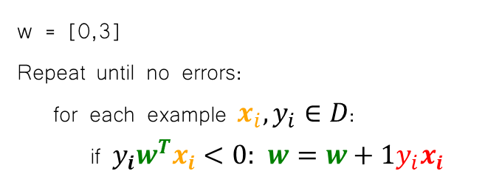

The Perceptron: Learning Algorithm By Hand
 | X1 | X2 | Y
1 | 3 | 4 | 1
2 | 6 | -3 | 1
3 | -3 | 9 | -1
4 | -7 | 6 | -1
w = [0,3]
Repeat until no errors:
for each example $x_{i}, y_{i}∈D$:
if $y_{i}w^{T}x_{i}<0:$ $w=w+1y_{i}x_{i}$
$$x_{2}$$
3
1
$$x_{1}$$
2
4

Slide 24

The Perceptron: Learning Algorithm By Hand
 | X1 | X2 | Y
4 | 3 | 4 | 1
2 | 6 | -3 | 1
1 | -3 | 9 | -1
3 | -7 | 6 | -1
w = [-3,3]
Repeat until no errors:
for each example $x_{i}, y_{i}∈D$:
if $y_{i}w^{T}x_{i}<0:$ $w=w+1y_{i}x_{i}$
$$x_{2}$$
1
4
$$x_{1}$$
2
3

Slide 25
Online vs. Batch Learning
We refer to the perceptron algorithm as an online learning algorithm because it updates parameters (aka learns) each time it receives a training example.
In contrast, batch learning algorithms collect a set of training examples and learn from them all at once. For example, the gradient descent algorithm we described for logistic regression is a batch algorithm.
(Note that gradient descent also has multiple online versions)

Slide 26
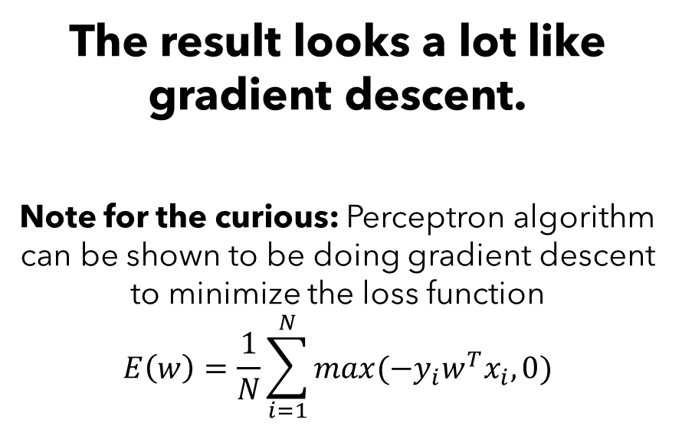

Online vs. Batch Learning
Could modify the perceptron learning algorithm to be a batch learning algorithm by accumulating updates over the whole dataset before changing the weights.
Batched Perceptron Learning Algorithm
$w$ = random(d)
Repeat:
$u$ = zero(d)
for each example $x_{i}, y_{i}∈D$:
if $y_{i}w^{T}x_{i}<0:$ // if misclassification
$u+=−y_{i}x_{i}$
$w=w−αu$
Until $\left|u\right|≤ε$
The result looks a lot like gradient descent.
Note for the curious: Perceptron algorithm can be shown to be doing gradient descent to minimize the loss function
$$E\left(w\right)=\frac{1}{N}\sum_{i=1}^{N}{max(−y_{i}w^{T}x_{i},0)}$$

Slide 27
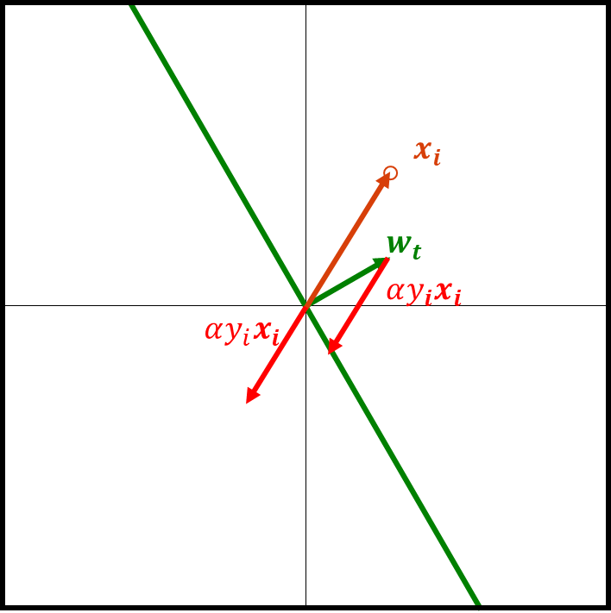
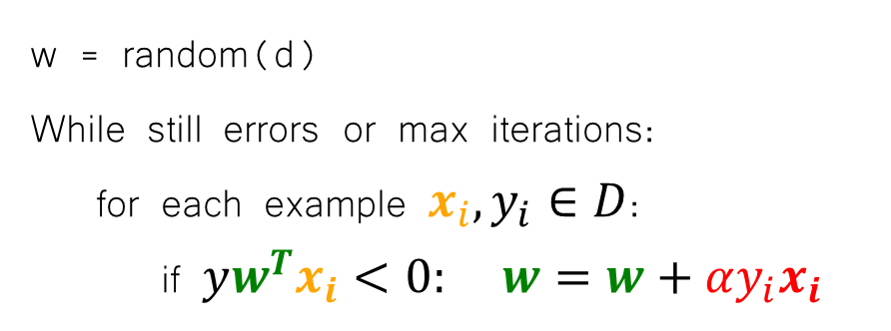
The Perceptron: Limitations
Perceptron Learning Algorithm
w = random(d)
While still errors or max iterations:
for each example $x_{i}, y_{i}∈D$:
if $yw^{T}x_{i}<0:$ $w=w+αy_{i}x_{i}$
Different solutions depending on initialization and order of visiting examples.
Correcting for a misclassification could move the decision boundary so much that previously correct examples are now misclassified.
As such it must go over the training examples multiple times. Each time it goes through the whole training set, it is called an epoch.
It will terminate if no update is made to w during one epoch

Slide 28


The Perceptron: Limitations
$$x_{2}$$
This algorithm is guaranteed to converge if data is linearly separable – i.e., it reaches a solution in finitely many steps.
Why and how many steps? (proof)
$$x_{1}$$
For non-linearly separable cases (like on right), algorithm fails to converge and may be arbitrarily bad if terminated at some maximum number of updates.

Slide 29
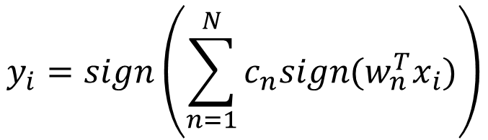

The Perceptron: The Voted-Perceptron Algorithm
One Idea: keep around intermediate hypothesis and have them “vote” –- i.e., a weighted average. [Freund and Schapire, 1998]
w = random(d)
n=0
While still errors or max iterations:
for each example $x_{i}, y_{i}∈D$:
if $yw^{T}x_{i}<0:$
$w_{n+1}=w_{n}+αy_{i}x_{i}$
$c_{n+1}=0$
$n+=1$
else:
$c_{n}+=1$
Store the weight vector after each error update along with the count of examples that weight was successful before making the error. Weights contribute relative to this value.
$$y_{i}=sign\left(\sum_{n=1}^{N}{c_{n}sign(w_{n}^{T}x_{i})}\right)$$

Slide 30
Perceptron Summary
Perceptron incrementally learns a linear decision boundary to separate positive from negative (two classes so binary classification).
It begins with a random or zero weight vector, and incrementally updates the weight vector whenever it makes a mistake.
For online perceptron, different orderings of the training examples can lead to different outputs. Algorithm will fail to converge if not linearly separable.
Voted perceptron can handle non-linearly separable data, and is more robust to noise/outlier.

Slide 31
Be able to answer:
What is the perceptron linear classifier?
How is it updated?
How to evaluate classification models?
Accuracy
Recall and Precision

Slide 32
Where are we?
We’ve covered a few predictive models so far in class:
Predictive Models:
Classifiers (given x, produce discrete y)
k-Nearest Neighbors Classifier
Logistic Regression (binary classification only)
Perceptron (binary classification only)
Regressors (given x, produce continuous y)
Linear Regression
k-Nearest Neighbors Regressor

Slide 33
Evaluating Classifiers
Accuracy: # correct / total
If I tell you, I have a ML product that can tell whether someone has a rare disease or not with 99.99% accuracy – are you impressed?
This is a binary classification problem – 0 = no disease, 1 = disease
What if the actual percentage of people with the disease is only 0.0001%?
My algorithm is worse than a model that said no-one was a sick which would achieve 99.9999% accuracy.

Slide 34




Evaluating Classifiers
Let’s consider all possible scenarios for a single prediction:
False Positive -- not sick but my model said they have the disease
False Negative -- sick but my model said they don’t have the disease
True Positive – sick and my model said they have the disease
True Negative – not sick and model said they don’t have the disease
$$Let y be the true label and \hat{y} be our prediction.$$
$$y=0, \hat{y}=1$$
$$y=1, \hat{y}=0$$
$$y=1, \hat{y}=1$$
$$y=0, \hat{y}=0$$

Slide 35
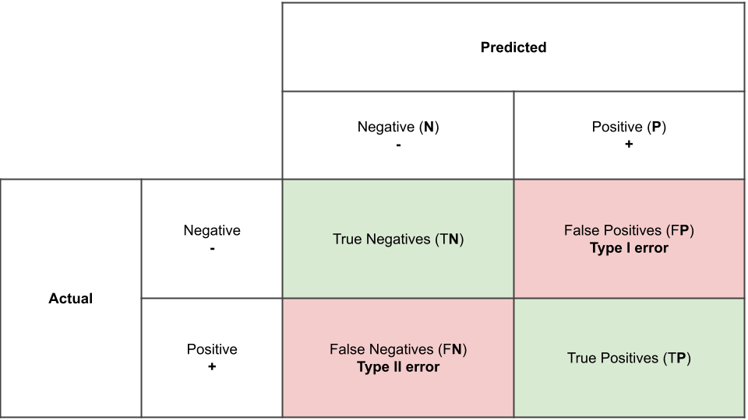
Evaluating Classifiers
These are often consolidated into what is called a confusion matrix.

Slide 36
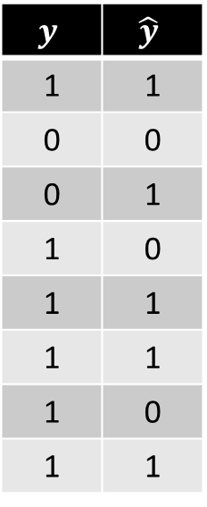
Evaluating Classifiers
These are often consolidated into what is called a confusion matrix.
$$y$$ | $$\hat{y}$$
1 | 1
0 | 0
0 | 1
1 | 0
1 | 1
1 | 1
1 | 0
1 | 1

Slide 37
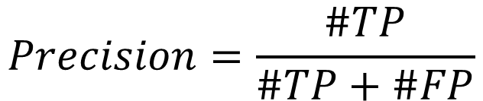
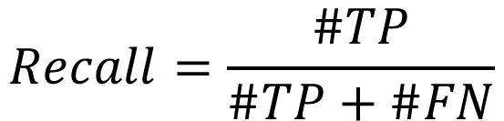
Evaluating Classifiers
Two useful composite measures:
Recall: What fraction of positive does your model predict as positives:
Precision: Of things your model predicts as positives, what fraction are correct?
$$Recall=\frac{\#TP}{\#TP+\#FN}$$
$$Precision=\frac{\#TP}{\#TP+\#FP}$$

Slide 38

If I have a model with low recall but high precision, I should trust it _________________________________________?
more when it predicts something as positive than if it predicts it as negative
the same when it predicts something as positive or negative
less when it predicts something as positive than if it predicts it as negative

Slide 39


Evaluating Classifiers
Let’s go a step further and think about classifiers that output a score:
We can write most of our models as doing the following:
For example, linear classifiers like logistic regression or perceptron can be:
$$Let y be the true label and \hat{y} be our prediction. Further let s be the \text{score} \text{of} \text{our} \text{model}\text{.}$$
$$\hat{y}=\left\{\begin{aligned}1 if s≥t \\ 0 else\end{aligned}\right.$$
$$\hat{y}=\left\{\begin{aligned}1 if w^{T}x≥0 \\ 0 else\end{aligned}\right.$$

Slide 40

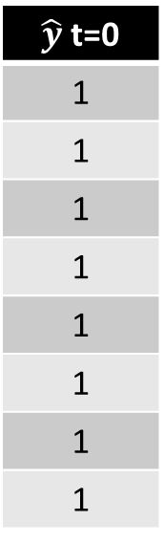
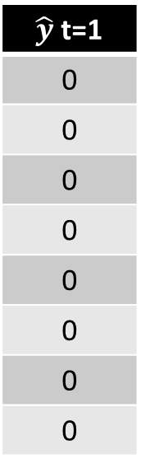
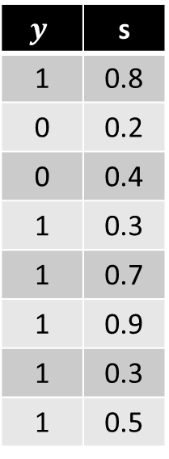
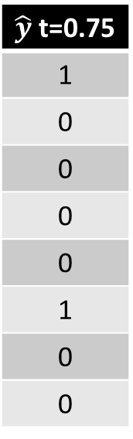
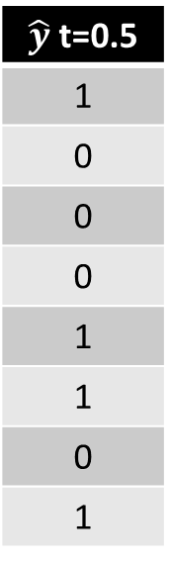
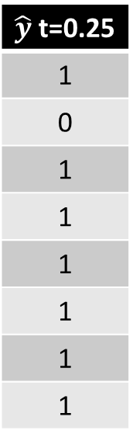
Evaluating Classifiers
$$\hat{y}=\left\{\begin{aligned}1 if s≥t \\ 0 else\end{aligned}\right.$$
Different settings of the threshold give different outputs.
$$y$$ | s
1 | 0.8
0 | 0.2
0 | 0.4
1 | 0.3
1 | 0.7
1 | 0.9
1 | 0.3
1 | 0.5
$\hat{y}$ t=0
1
1
1
1
1
1
1
1
$\hat{y}$ t=0.25
1
0
1
1
1
1
1
1
$\hat{y}$ t=0.5
1
0
0
0
1
1
0
1
$\hat{y}$ t=0.75
1
0
0
0
0
1
0
0
$\hat{y}$ t=1
0
0
0
0
0
0
0
0
And thus different recall/precision values – seems like something we can tune.

Slide 41
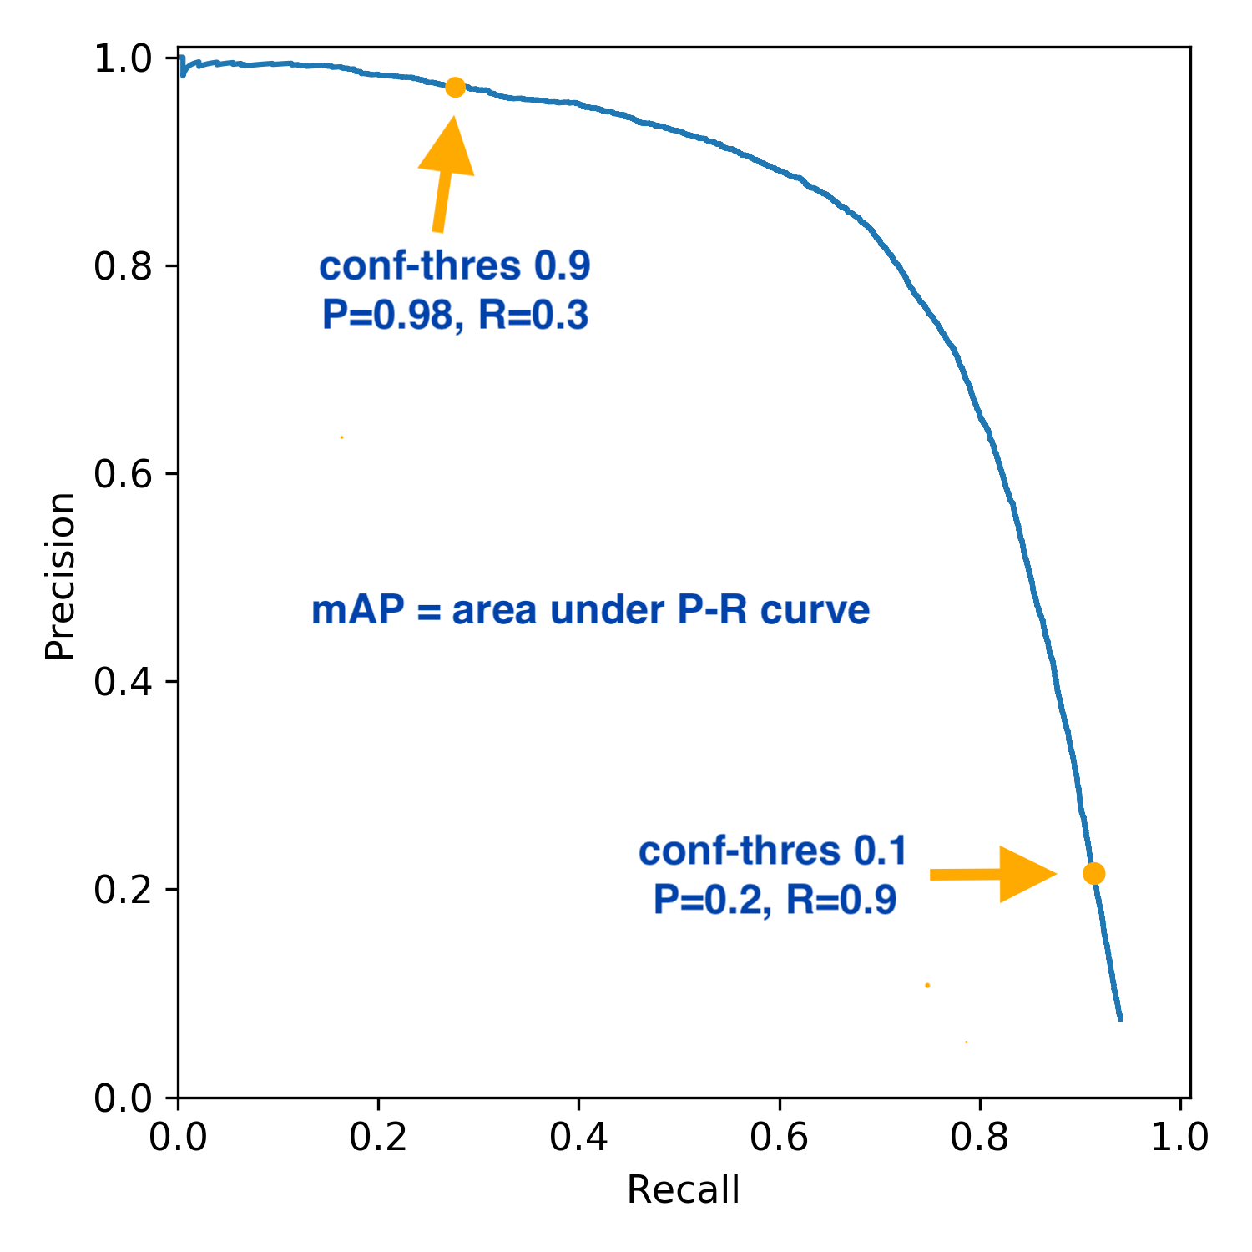
Evaluating Classifiers
Idea: Vary the threshold from its minimum to maximum value and plot the resulting sequence of recall and precision values on a curve.
Call this a precision-vs-recall plot.
Tells us the full range of precision and recall values our classifier can take.
Can be used to compare classifiers or to help us pick optimal settings for a classifier based on our needs.

Slide 42
If a disease can be easily treated early but has devastating effects if given time to develop, we might prefer a classifier with high _______?
Accuracy
Precision
Recall

Slide 43
Suppose you have an earthquake warning system with very high recall but low precision. How might people react to this system over time?

Slide 44
Be able to answer:
What is the perceptron linear classifier?
How is it updated?
How to evaluate classification models?
Accuracy
Recall and Precision

Slide 45
Next time
Next Time: We’ll talk about Naïve Bayes and classification problems with more than two classes!

